Slide 1



Synthetic Aperture Radar Imager
Final presentation
ece team 11 and ME Team 18
4/14/2016

Slide 2
Team Members
Engineer | Role(s) | Major | School
Luke Baldwin | Main Structure | Mechanical | FSU
Olivier Barbier | Data Processing & Image Formation | Electrical & Computer | FAMU
Jordan Bolduc | Signal Processing | Electrical | FSU
Josh Dennis | ME Project Manager & Procurement | Mechanical | FSU
Scott Nicewonger | EE Project Manager & RF | Electrical | FSU
Kaylen Nollie | Secretary, Risk Management | Mechanical | FAMU
Desmond Pressey | Antenna Hardware & Webmaster | Mechanical | FAMU
Julian Rodriquez | Component Housing | Mechanical | FSU
Kegan Stack | Calibration & Alignment | Mechanical | FSU

Slide 3
Introduction
Josh Dennis

Slide 4
Agenda
Introduction to SAR
1st Generation
Project Goals
ME Team Accomplishments
ECE Team Accomplishments
Future Work

Slide 5
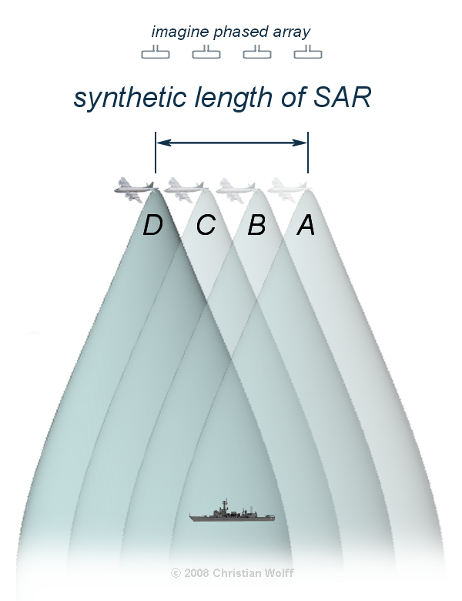
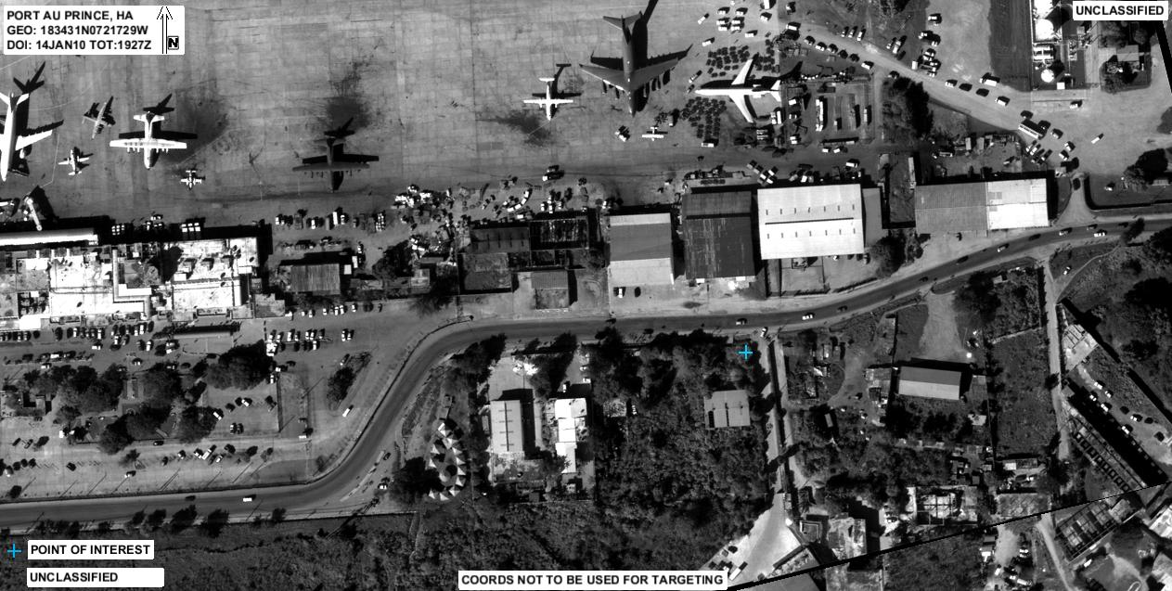
SAR Introduction
What is SAR?
Synthetic Aperture Radar: Typically, a single antenna is attached to an aircraft flying over a target zone capturing several wide-beam images, and combines them into a single, high-resolution, narrow-beam image.

Slide 6

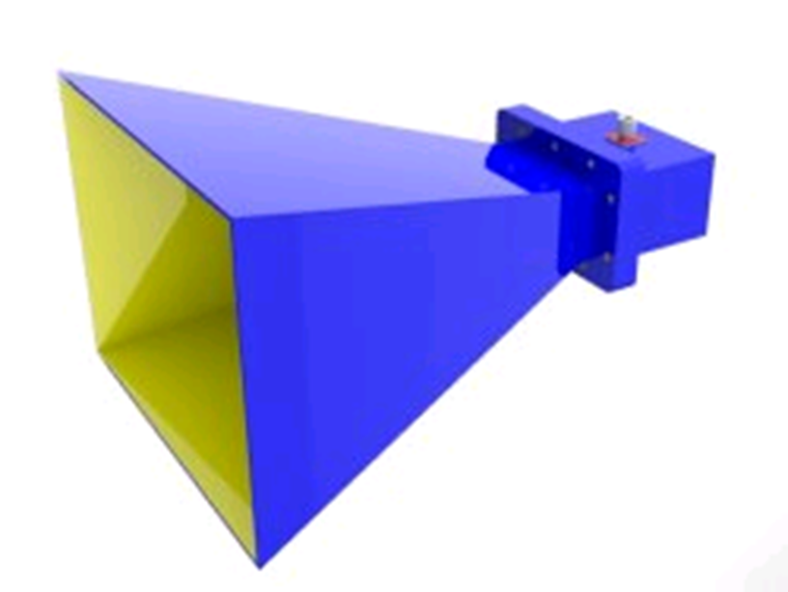
Image Formation
40 x 40 inch scene
16 - 2.5 inch
1-D Cells in
Azimuth and
Elevation
PC Display
Antenna Array
20 [ft] range to scene center
5 x 5 feet
Beams are formed
Digitally with Fourier
Transform, 16 in Azimuth
And 16 in Elevation
20nS wide RF
Pulse @ 10 GHz
16 - Azimuth
16 - Elevation
VGA Connection

Slide 7

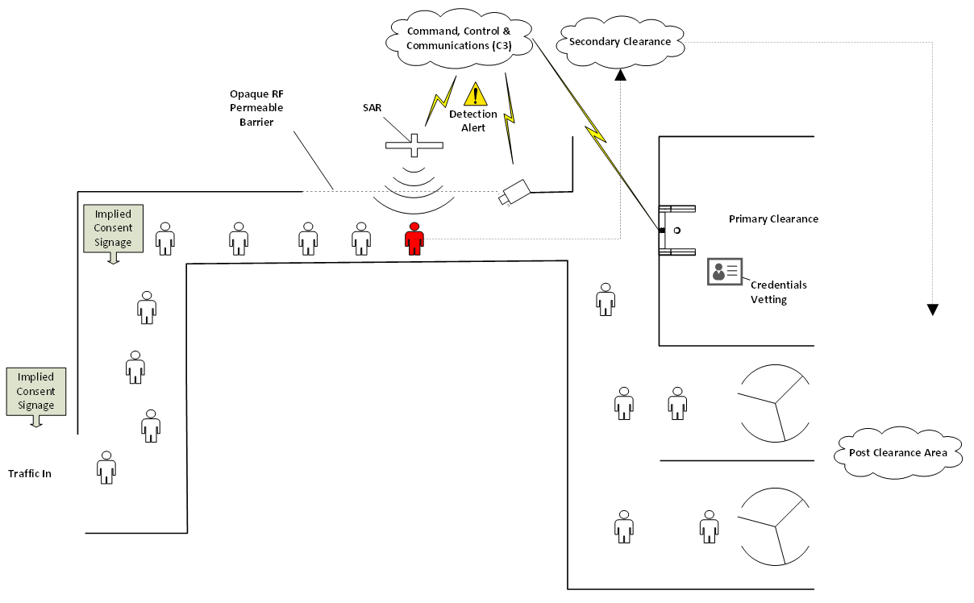

Applications
Concealed Weapon Detection at an Access Control Point
Security industry: protection of high risk areas
Supplemental measure for layered security environments
Primary measure for certain environments
Unique Capabilities
Ranged scanning $⇒$ no apparatus to step into
Discreet placement
Vett the queue before individuals get to Access Control

Slide 8
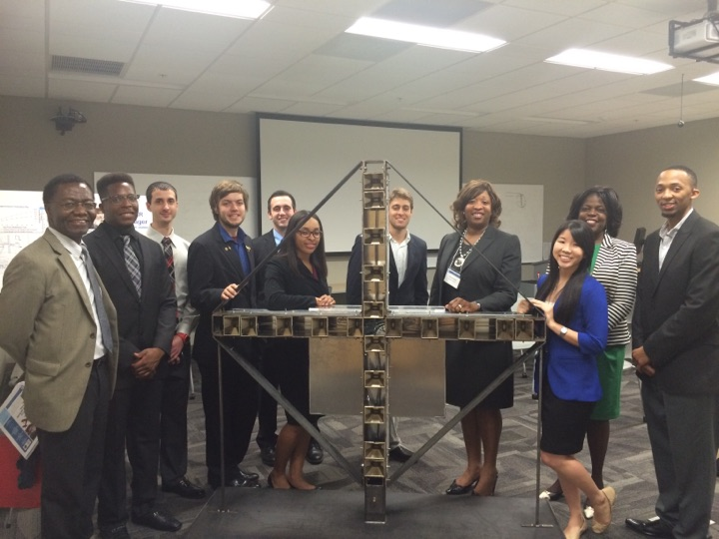
First Generation Goals
Create a Synthetic Aperture Radar:
  Project Features:
    Weapons detection for homeland security
    Multi-Antenna
    Stationary
    Low resolution
    Concealable
    Low Cost
    Relatively mobile
1st Generation Project – Class of 2015

Slide 9
Second Generation Goals
Mechanical Engineering
Mobility
Lower Weight
Horn Adjustment
Increase Stability
Minimize Cost
Electrical Engineering
Identify reflector at 20 feet
FPGA System Control
FPGA & MATLAB Signal Processing

Slide 10
Structure & Component Housing
Luke Baldwin

Slide 11
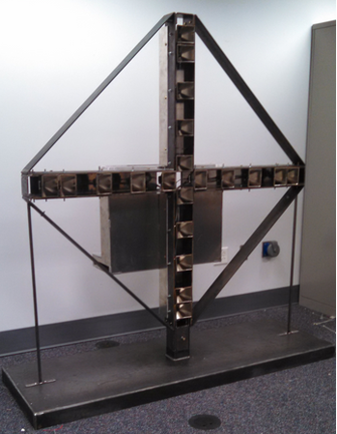
Structure Goals
Mobile
Lightweight
Stable
  Movement causes phase error
Modular
Generation I Array

Slide 12
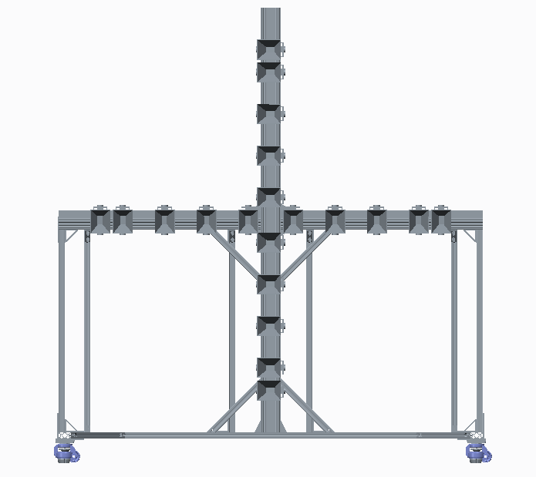
FRAME V 4.0
66”
Status: Assembled
Weight: 55lbs
Cost $700
What’s left?
  Optimizing for stability & stiffness
    Additional sections, gussets & leveling feet
    Loctite & torque all fasteners
30”
7.09”
3.54”
Leveling castors
70”

Slide 13

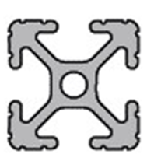
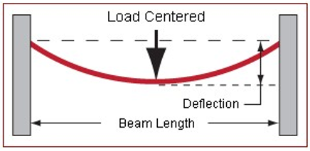
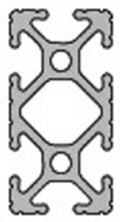
Structure Force Analysis
Issue: bottom beam deflected
  Someone stood on beam
Beam length of 62” only supported at ends
Original 1010
  Deflection of 0.0623(in)
New 1020
  Deflection 0.0098 (in)
  6X less deflection

Slide 14
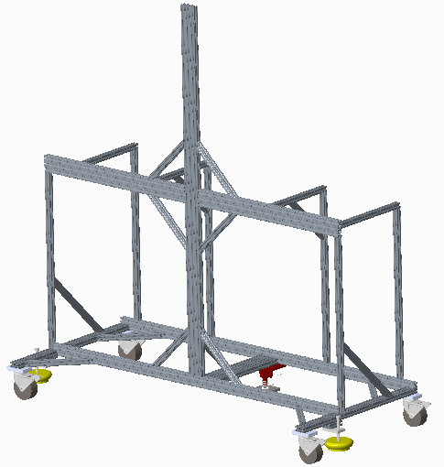
Structure Revision: V 4.1
Addition to current structure
Switch to rubber 4” casters
  No leveling caster presents alignment dilemma
  Solved with foot floor lock (red) and adjustable vibration feet (yellow)
Additional gussets to stiffen the structure
Base pieces changed to 1020
1030 piece added to middle of base to unify base
New leveling system not implemented
Gussets
Changed to 1020 series
1030 series

Slide 15
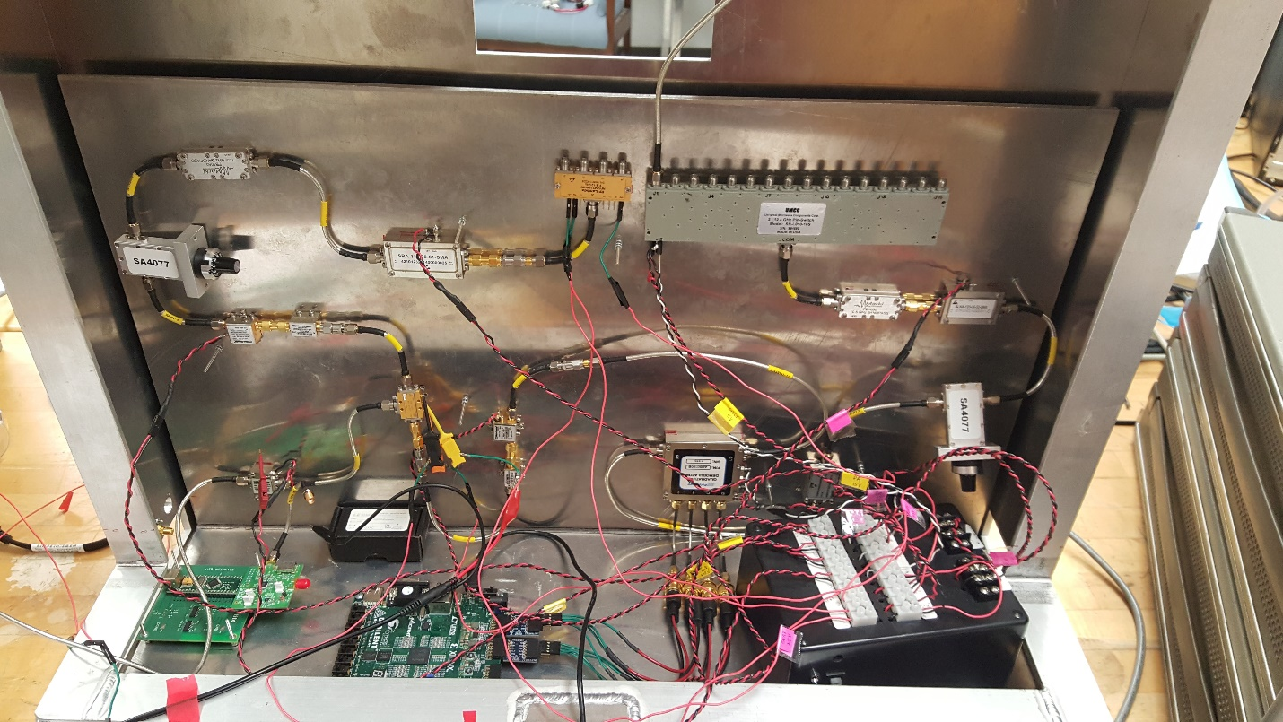
Component Housing Goals
Easier interface
Secure components
Organized layout
Sufficient heat dissipation
Electromagnetic Interference (EMI) protection
Generation I Component Housing

Slide 16
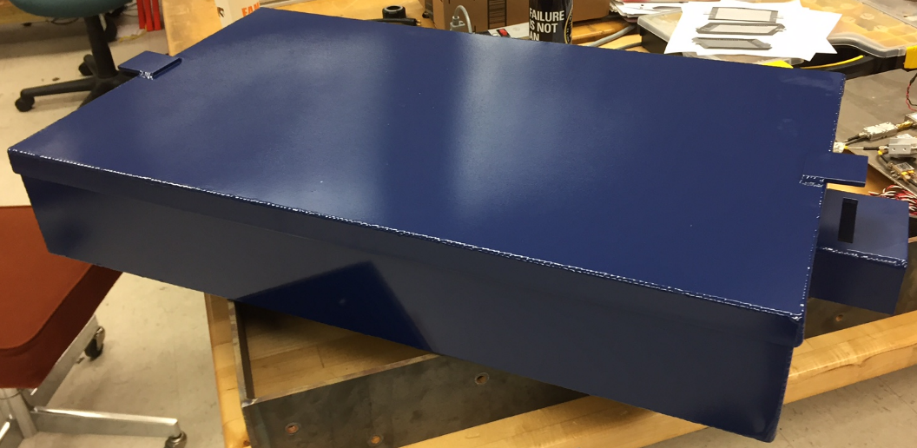
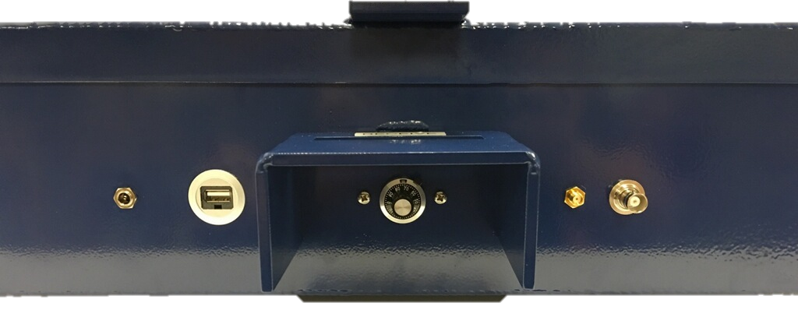
Gen II Component Housing
Assembled
  Water jetted
  Welded
  Powder Coated
Machine Shop Error
  Redesign component layout
EMI Shielded
  Conductive gaskets
  Panel-mount interfaces
Weight: 12.9 lbs w/o components
Full Enclosure
Panel Interface & Attenuation Control
Notes:
The design philosophy for the box was to first and foremost be accessible for the electrical engineers to conduct their testing as well as being as sealed from the outside environment as much as possible to protect from EMI, in which I will speak about in further detail later. Every input and output to and from the box goes through a panel mounted connection to not only enclose the box but also to make connections as simple as possible. The image above is a view which hides the walls to better show each connector installed into the box. Aluminum 6061 was selected due to its high electrical conductivity, strong weldability, and of course cost. The weight is approximately (12.9 lbs) compared to last year’s weight of (roughly 40lbs) down 67.75%. The latches on the side ensure the enclosure is properly shut when needed, and have the option to install padlocks if need be.

Slide 17
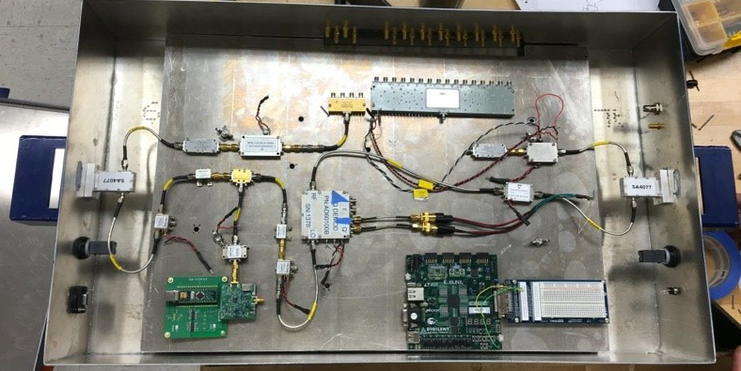
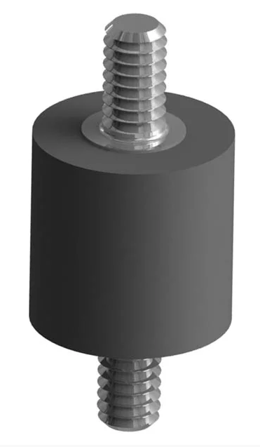
Installation – Electrical Components
Drop-in tray
  Removable
  Modular
  Vibration-dampening
  standoffs
Internal View
Notes:
**Might want to briefly mention RF shielding since you mentioned it in slide 2. Also, we can take a new picture with it wired up now. –Scott **
With the new dimensions for the box, some recalculations had to be made to determine the new thermal analysis. After changing the surface areas and thicknesses within the MatLAB code I created for thermal analysis, again using a Thermal Resistance Network, the total heat dissipation possible actually went up. Previously, the box would have only been able to dissipate approximately (155.37 W) compared to now with a value of (178.08 W). That is up by (14.6%). With this new heat dissipation, this translates to a factor of safety of (5.12).

Slide 18
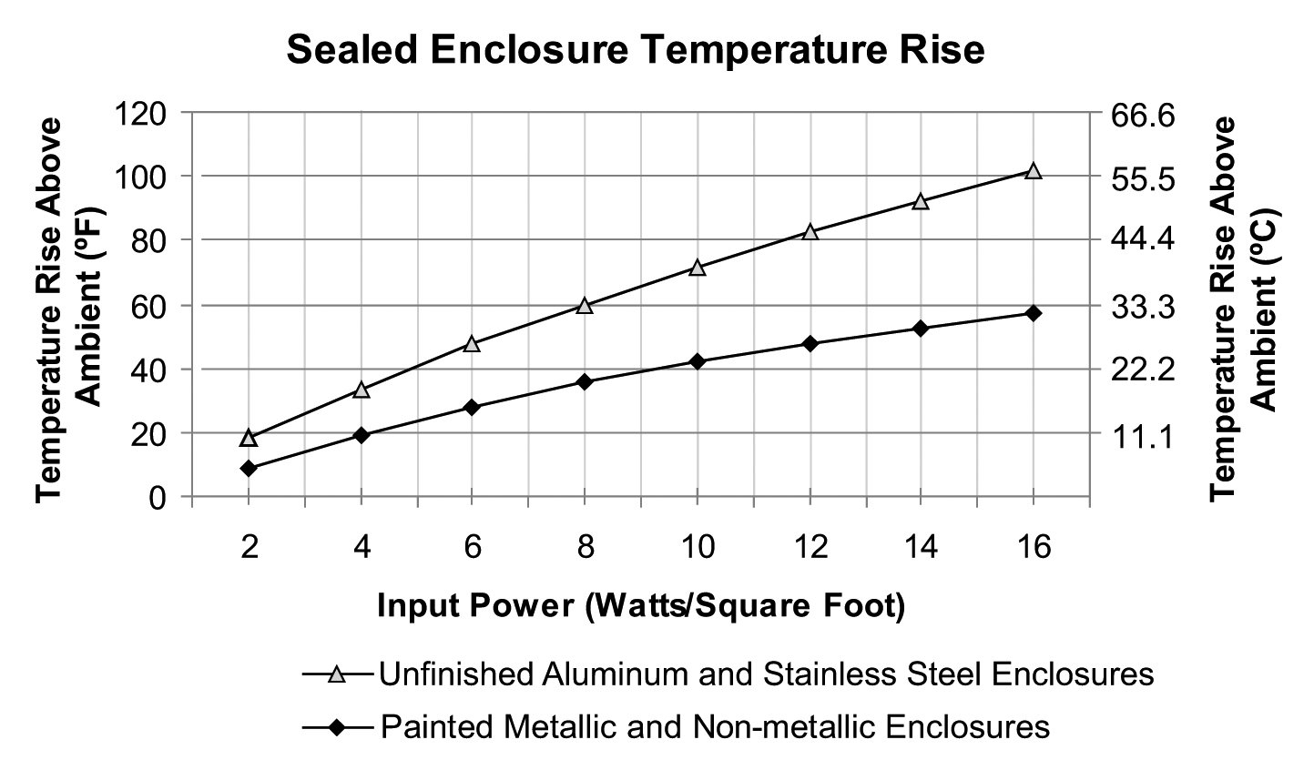
Thermal Analysis
Previous temperature rise: 16.65° C (before paint)
Current temperature rise: 9.5° C (after paint)
  Radiant heat transfer efficiency
42% Enclosure temperature decrease
Highest enclosure temperature: 30.5° C
Component maximum operating temperature: 50° C
Notes:
Explain chart from Pentair’s (thermal and fluid mgmt. comp) technical document. With the surface area about 10.5ft^2 and total power supplied to components - is 34.8 W. The heat flux is around 3.32. Using the graph one can determine the temperature rise. State previous enclosure before paint, 16.65 increase = 37.65 C, assuming room temperature of 21 C. After paint, only 9.5 C increase = 30.5 C. This is due to an aluminum’s unfinished surface less efficient radiant heat transfer. This translates to 42% decrease on enclosure temperature. Since the most sensitive component’s failure temp is at 50 C, then it is deemed safe by a large amount (19.5 C)

Slide 19
Horn Holders & Testing
Desmond Pressey

Slide 20
Horn Holder Design
Design Goals
  Independent axis adjustability
  Independent axis locking
  Lightweight
  Ease of adjustability and alignment
  No clearance issues

Slide 21
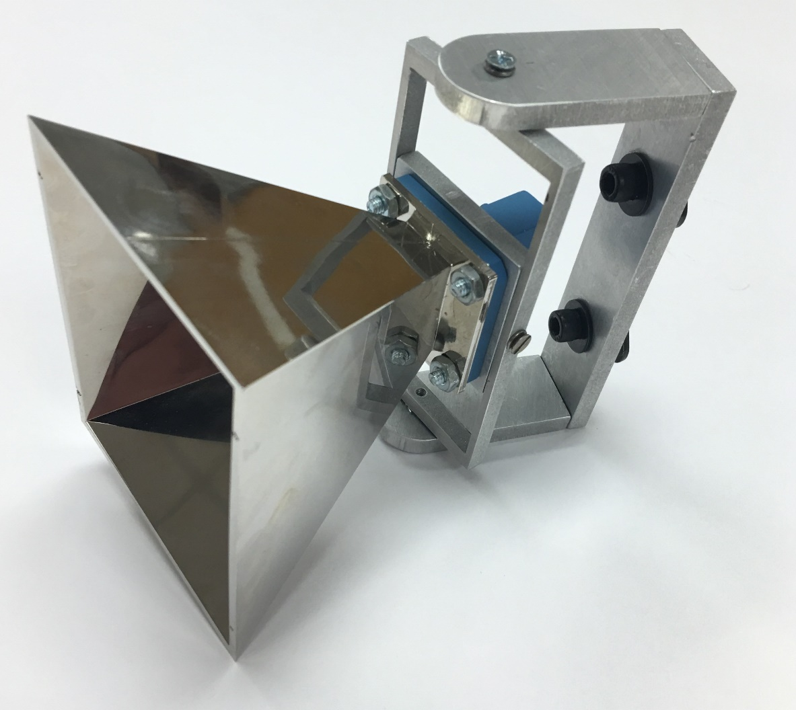
Horn Holders
2.5”
Tolerance issues
  Expectations: +/- 0.003 inch
  Reality: +/- 0.010 inch
Unable to use star washers
  Reduces locking ability
Successfully utilized in testing
Hardware Cost: $15 per horn holder
1”
4.64”
Notes:
This is where you could elaborate on how we met the design goals set in slide 2

Slide 22
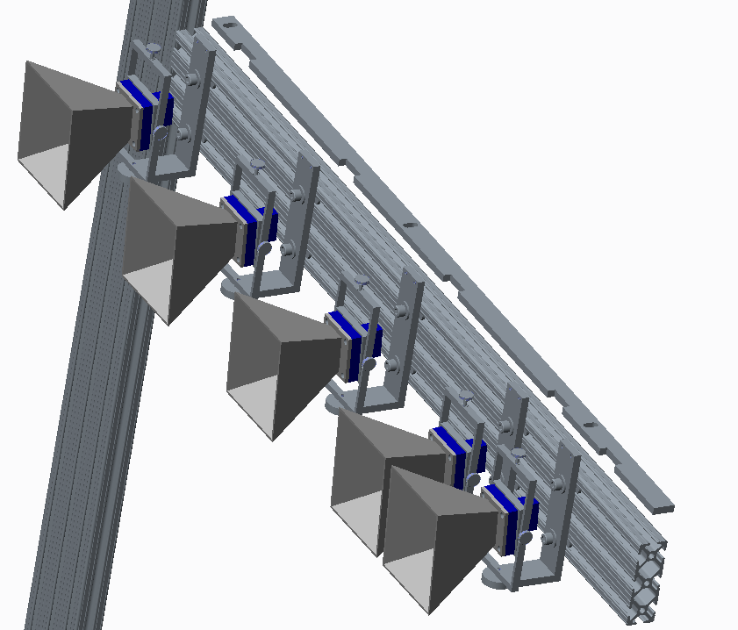
Horn Spacing - Jig
Simplest way to ensure exact horn spacing
Cut in house with the water jet
  Accurate to within 0.003”
Repeatable: Measures from the intersection of the frame – out
Jig

Slide 23
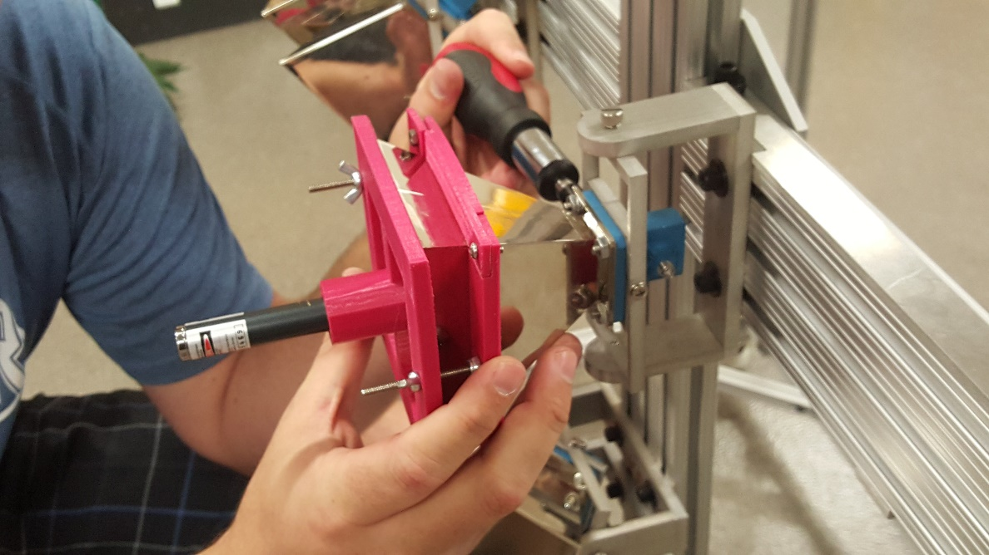
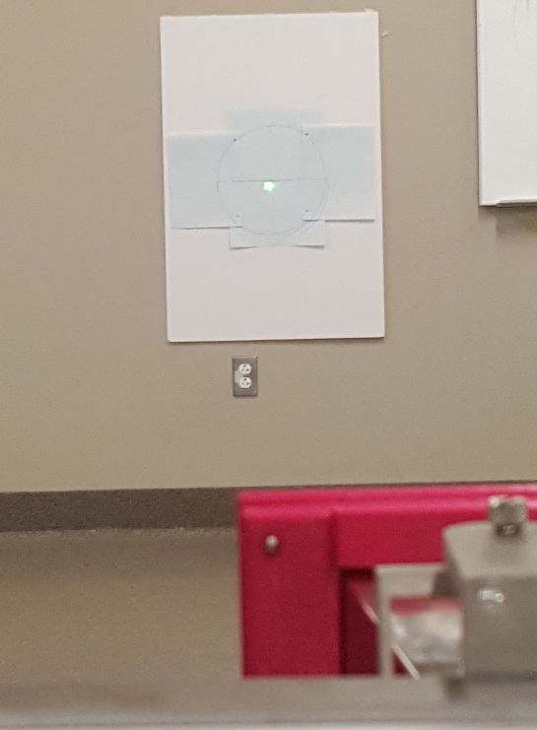
Horn Calibration – 3D Printed Brackets
Align within 5°
Distance: 20 ft
Laser pointer
Issue with laser pointer:
  Laser beam was not centered within laser pointer
  Solved through digital calibration

Slide 24
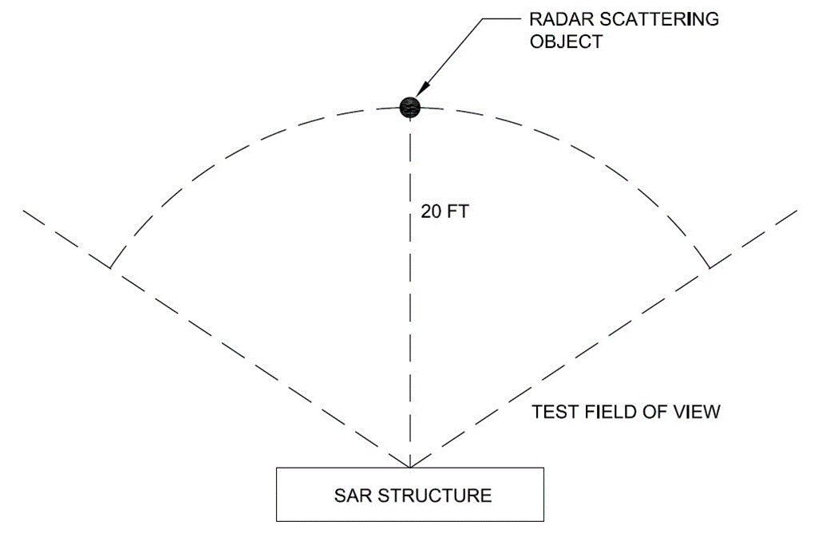
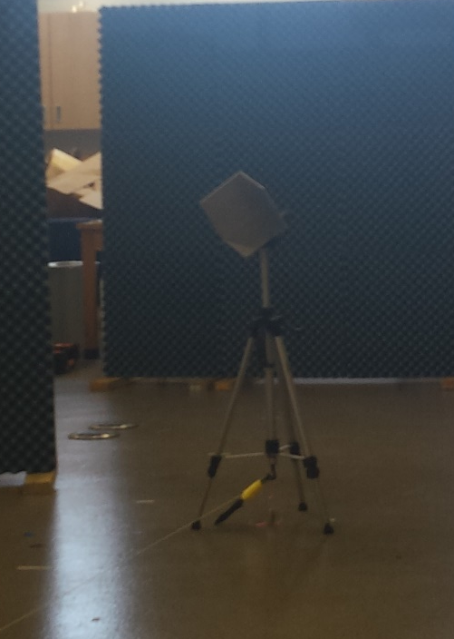
Radar Reflectors
Purpose is to create backscatter
  Reflects transmitted RF back to receiving horns
Transmit
Receive
RADAR Corner Reflector

Slide 25
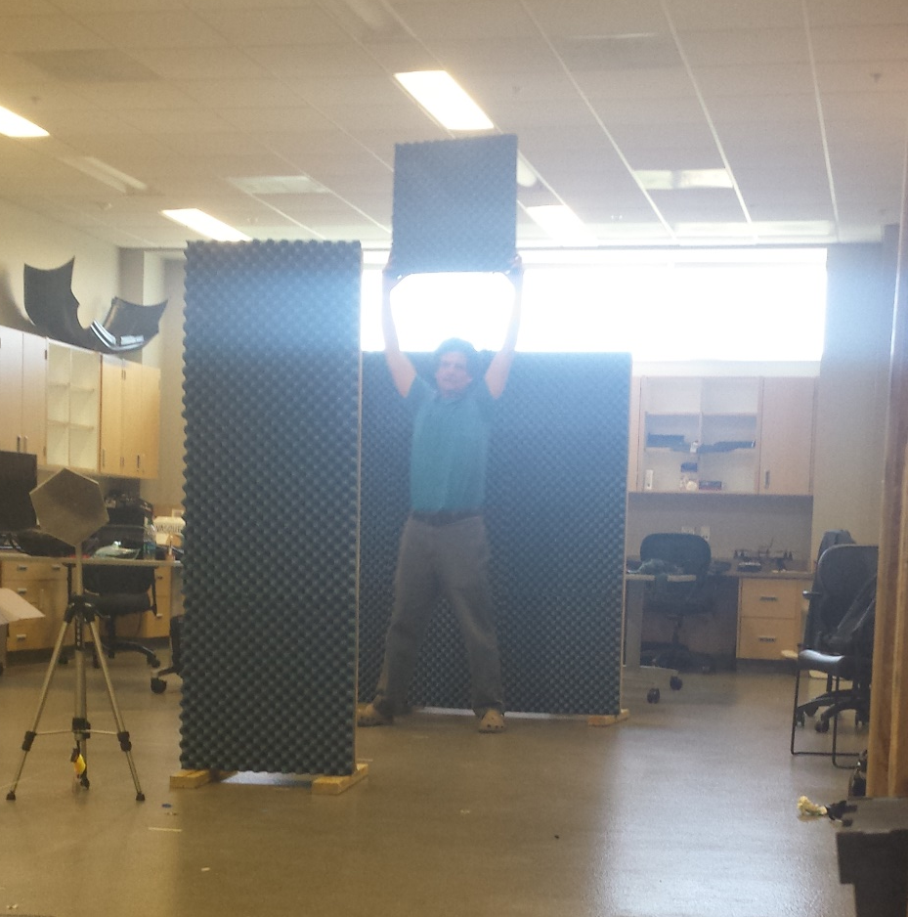
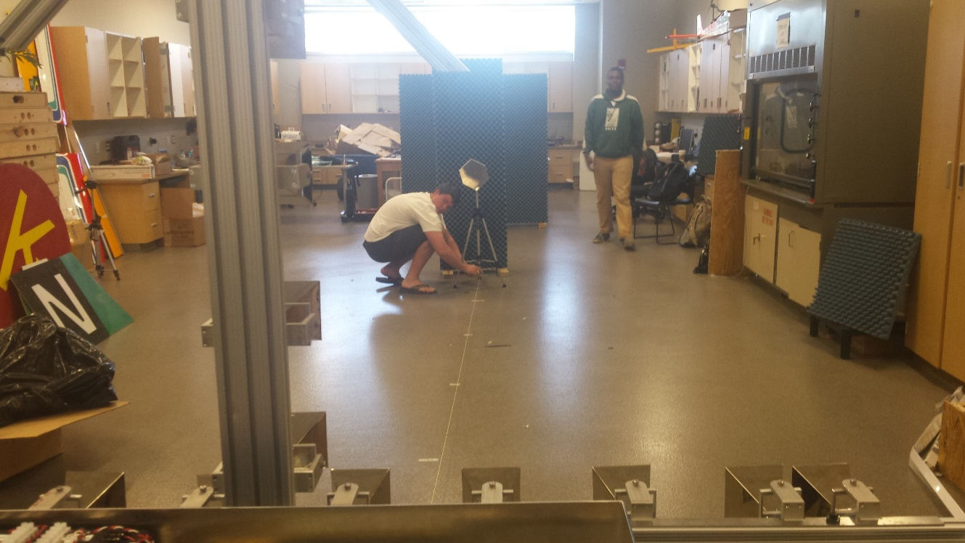
Room Setup
Considerations:
  Room requirement (30 ‘ x 30’)
  Minimal RF interference
Boresight Angle Alignment
Multipath Fade Point Empirical Determination

Slide 26
  Theory of Operation
Scott Nicewonger

Slide 27

Real Transmitter
TX
Synthesized Transmitter/Receiver
with Aperture Length d
TX / RX
d
Phase Center
$$≈$$
Reflective Target
RX
Real
Receiver

Slide 28
Stationary Scanning
1-D Side View
Front View
TX
PC 1
RX₁
TX
RX
PC 2
RX
Phase Centers are formed at the midpoint between each transmitter/receiver pair
Pulsing a linear array of receivers enables a scan of the target area without any moving parts
Imager consists of linear arrays in X and Y axes to scan the entire scene
RX
PC 3
RX₂
RX
PC 4
TX
RX
RX
RX
RX
RX
RX
RX
RX
TX
RX
RX
RX₃
RX
RX
TX
RX₄

Slide 29


Phase Slope
θ
nd sin(θ_{n})
3d sin(θ_{n})
16 Phase Centers
16 θ_{n} ‘s that map to 16 unique regions in the scene
For each θn , a 16-point complex basis function is generated
Received data is convolved (DFT) with basis functions to map energy amplitude VS frequency
2d sin(θ_{n})
d sin(θ_{n})
d
R
$$≈$$
Downrange
Scene
θ_{n}
R $≈$R cos θ
d = 3λ

Slide 30
Prototype Design Goals
Electrical Engineering
Identify radar reflector at 20 feet
FPGA signal processing for real-time & standalone functionality
MATLAB signal processing for testing & future development

Slide 32
System Control
Olivier Barbier

Slide 33
Xilinx NEXYS 3 FPGA Board
FPGA Controls:
Switching Between Transmit Mode & Receive Mode
Data Processing and Logic
  ADC to Read Voltages from IQ Demodulator
  Read & Write to Memory
VGA output
  16 Columns – Dedicated Display
Olivier Barbier

Slide 34
Approach
Using board switches to control the Transmit and Receive antennas
  Understand the logic of the switches
Control VGA signal from the FPGA
  Initial goal is to create 16 columns that represent the 16 phase center
Create a fast pulse signal to control the SPDT
Saving data to the memory chip on the FPGA
Olivier Barbier

Slide 35
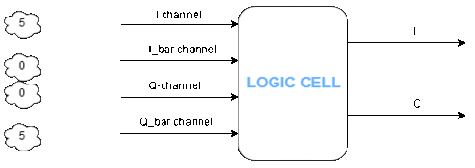
Obstacles
Digitalize negative analog voltage
  Added noise for step up circuit
  Solution: Utilization of the 4 Channels from the IQ demodulator
Olivier Barbier

Slide 36
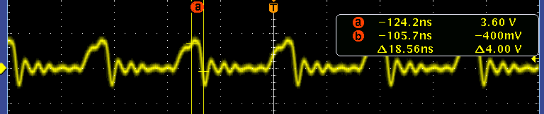
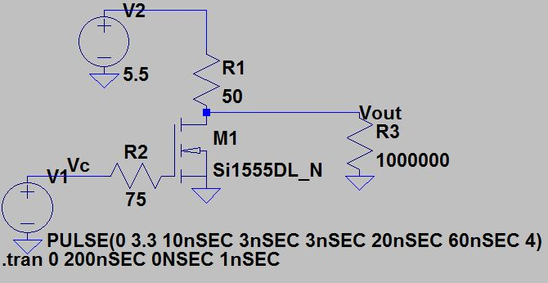
Obstacles(Continued)
Need clean high speed square wave pulse to drive the SPDT
FPGA Output
Solution: High speed MOSFET switch
MOSFET Switch Design

Slide 37
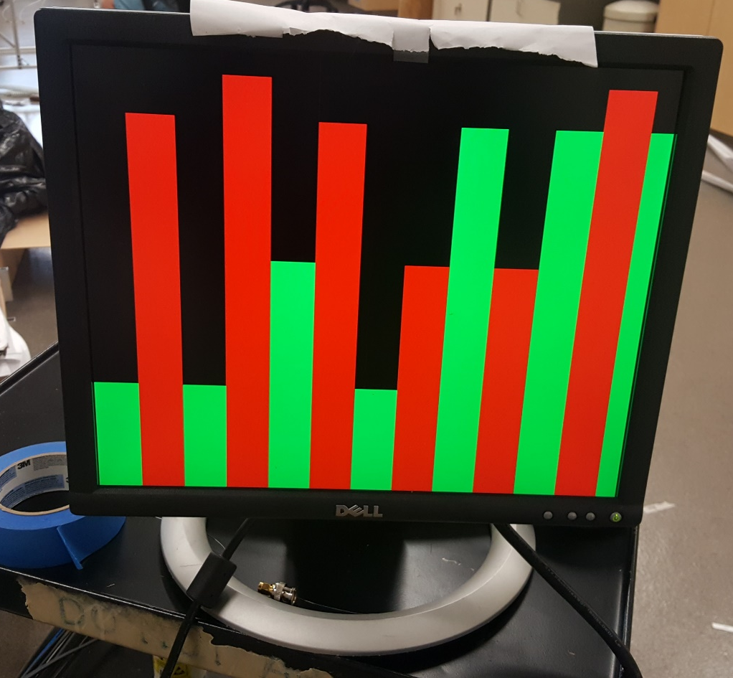
Final Program
Created a finite state machine.
  Debug mode : use switches to change antenna
  Real time mode (V1): logic switch antenna every 5 seconds
  Memory: load data to memory, that can be transported to MATLAB
Create VGA output control
Dedicated VGA Display Output

Slide 38
  Signal Processing
Jordan Bolduc

Slide 39
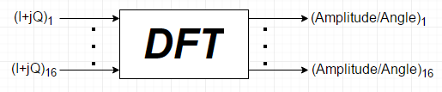
Signal Processing Approach
Reflected signal comes in as two separate components
Amplitude and angle of arrival information is necessary for energy at the scene
A Discrete Fourier Transform (DFT) is necessary
Phase Information From Target
Spatial
Information
To Display
Notes:
You can probably put a little more on this slide

Slide 40
Goals for Signal Processing
End goal for product is for Signal Processing on the FPGA
Was working towards implementing a Fast Fourier Transform (FFT) algorithm
Decided to move to work towards an initial MATLAB solution
  Data Manipulation
  Testing and debugging

Slide 41
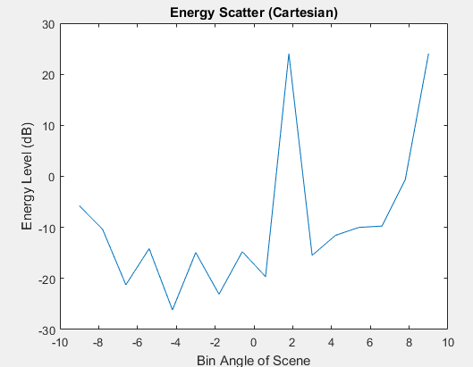
MATLAB Functions
Discrete Fourier Transform (sarFFT.m)
  Calculates Fourier Transform
Read From FPGA (readI.m & readQ.m)
  Pulls data from FPGA
Calibration
  Corrects for Phase Slope Error

Slide 42
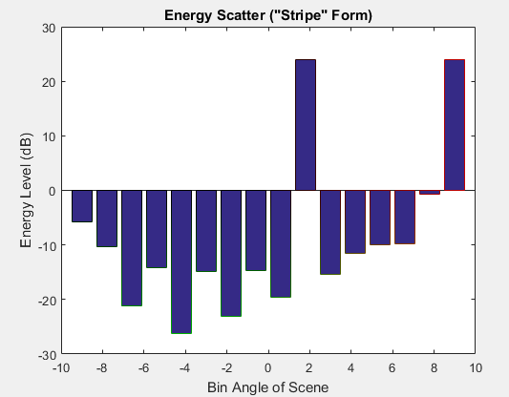
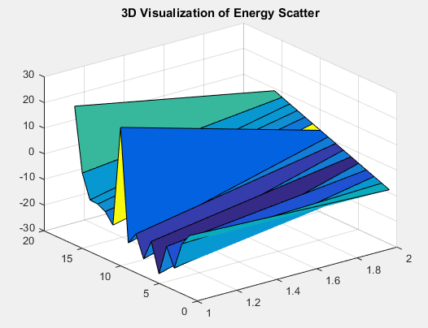
Image Formation
  Data Visualization in 2D and 3D

Slide 43
Full-Scale Range Test Results
Jordan Bolduc

Slide 44
RF Range Testing
Room Top-View
Transmitter
RF Absorber
Receivers
-5°
Corner Reflector
Transmitter
SAR

Slide 45
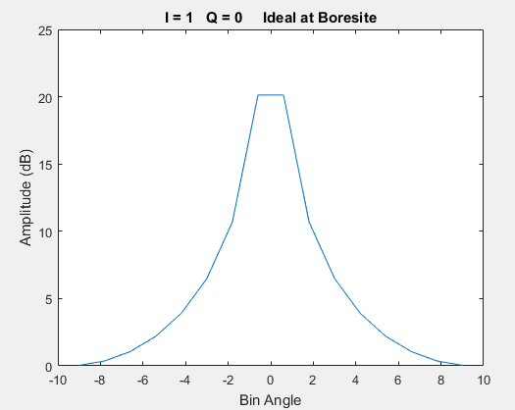
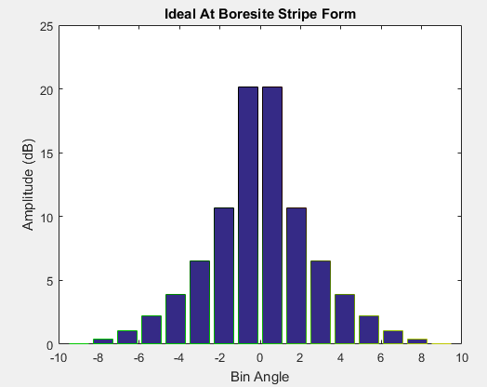
MATLAB Simulations

Slide 46
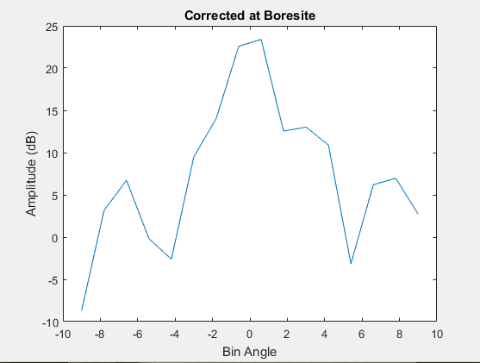
Simulation VS RF Range Measurements

Slide 47
Phase Slope Point of View (Boresight)
Phase
Phase Slope

Slide 48
Phase Slope Point of View (-5° from Boresight)

Slide 49
Error Discussion &
Mitigation Strategies
Scott Nicewonger

Slide 50
Amplitude & Phase Distortion

Slide 51
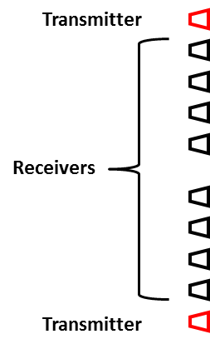
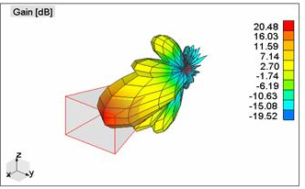
Adjacent Antenna Near Field Effects
TX
RX
Horn Antenna Radiation Pattern
LNA2
LNA1
LNA2 still recovering from saturation when receive mode activates
3D Figure: http://www.wipl-d.com/applications.php?cont=antenna-design/aperture-antennas

Slide 52
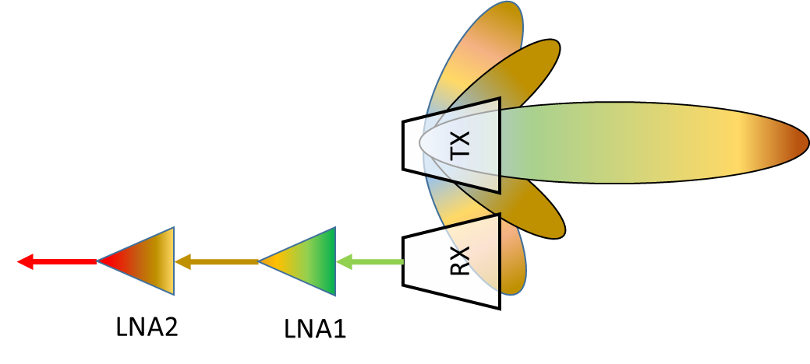
RF Isolation Approach 1: Physical Dimensioning
Increase distance to nearest receiver will:
Mitigate bleed-over signal
Change phase center locations
  Re-calculate phase slope
  Modify signal processing logic
TX
d
RF Absorber (Optional)
RX
LNA2
LNA1

Slide 53
RF Isolation Method 2: Receive Mode Switch (Design 1)

Slide 54






Indoor Phase Distortion
Room Top-View
RF Absorber
Floor
TX
Reflector
Receiver
$$Target φ_{1}$$
$$Multipath φ_{2}$$
RX
$$Multipath φ_{3}$$
…
$$Multipath φ_{4}$$
…
$$Multipath φ_{m}$$
$$NearField Effects (Bleedover) φ_{b}$$
$$System Noise φ_{N}$$

Slide 55
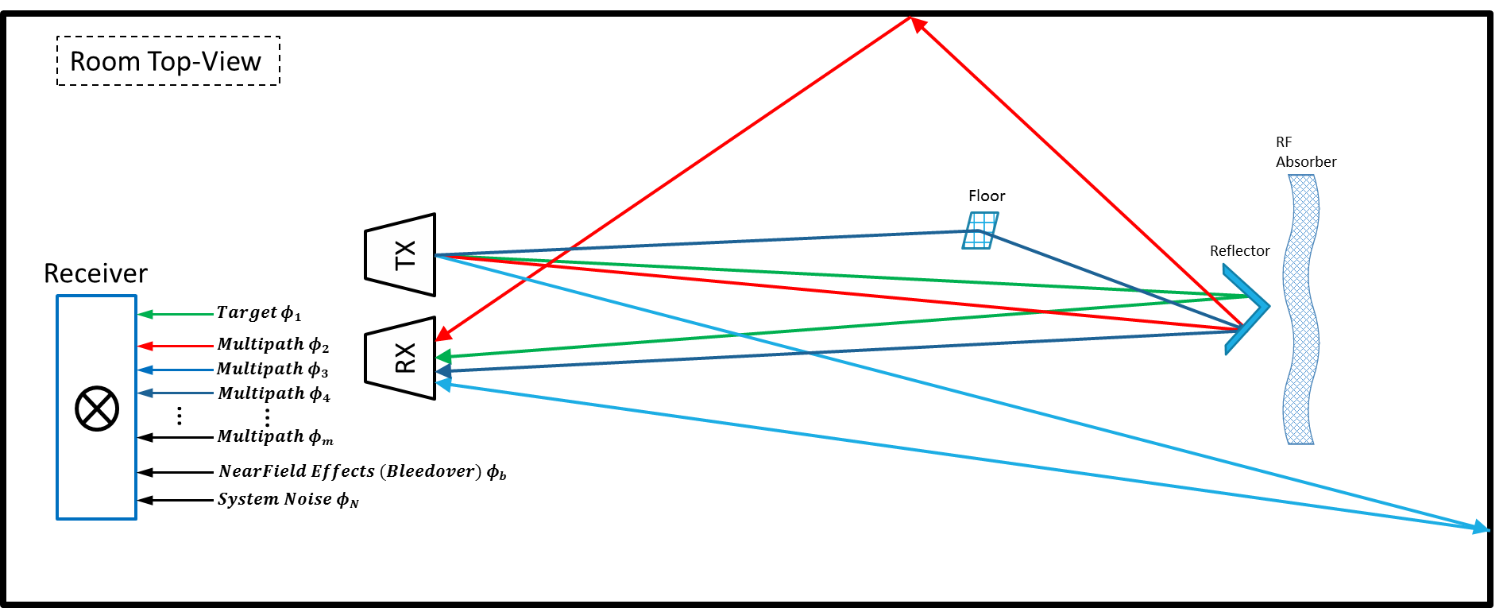
Multipath Mitigation
Extensive outdoor testing & data collection
Continue design refinement for outdoor environment
With outdoor baseline data in-hand, test indoors & compare data sets
Investigate mitigation strategies (physical & DSP)

Slide 56
Timeline & Budget
Scott Nicewonger & Josh Dennis

Slide 57



FAMU/FSU COE Synthetic Aperture Radar
Spring 2016 Timeline
4 days
Component Housing Fab & Assembly
3/14/2016 - 3/17/2016
8 days
Gen II Migration
3/18/2016 - 3/25/2016
5 days
RF Test Range Setup & Alignment
3/21/2016 - 3/25/2016
7 days
Delay Line Bench Testing
3/23/2016 - 3/29/2016
6 days
RF Range Testing
3/30/2016 - 4/4/2016
6 days
Neural Network Development & Testing (Strech Goal)
3/30/2016 - 4/4/2016
4 days
Data Documentation & Analysis
4/5/2016 - 4/8/2016
5 days
Closure & Gen III Hand-Off Plan
4/11/2016 - 4/15/2016
Final Report, Final Webpage, Notebooks
4/8/2016
Presentation II (Date TBA)
Final Presentation & Open House
3/25/2016
Operation Manual & Design Report
4/1/2016
4/14/2016
2016
03/07
03/11
03/15
03/19
03/23
03/27
03/31
04/04
04/08
04/12
04/16
04/20
2016
Today
3/13/2016
4/4/2016
Spring "Break" End
Gen II Prototype Verified
3/29/2016
Gen II Prototype Complete

Slide 58
Budget Overview, 2015-2016

Slide 59
Expenditures Overview, 2014-2016

Slide 60
Conclusions
SAR can successfully detect RF corner reflector at operational distance
Considerable phase distortion due to:
  Adjacent Tx/Rx near-field effects
  Multipath interference
Can write & read data to FPGA
  Manual Mode operation
  Instantaneous data points (non-real-time)
VHDL Control logic complete
  Need voltage step-up switch circuit
MATLAB signal processing backbone complete
VGA Display logic complete
Gen II Array Structure & Component Housing
  Robust
  Drastic weight reduction
  Modular

Slide 61
Future Recommendations
Fall 2016 – Spring 2017
New voltage step-up switch circuit for FPGA switching
RF Isolation
  Implement Isolation Switch or Array re-design
Extensive Outdoor Testing to establish baseline, then indoor testing to quantify indoor multipath effects
Real-time data processing (VHDL and/or MATLAB)
Investigate Neural Network implementation
Fall 2016 and Beyond
Patch Antenna Array Re-design
  Collab with HPMI Printed Sensors lab
Phase Slope Simulator
  Coaxial line stretcher & switch to simulate Rx phase slope
Future Project: Phased Array Radar
  Use SAR array backbone
  Drop-in phased array module
  Year 1: Manual beam steering with coaxial line stretchers
  Year 2-3: Digital Beamforming

Slide 62
Acknowledgements!
Sponsors:
Northrop Grumman
Pete Stenger
Mike Blue
Advisors:
Dr. Simon Foo
Dr. Shonda Bernadin
Dr. Rajendra Arora
Dr. Dorr Campbell
Instructors:
Dr. Jerris Hooker
Dr. Nikhil Gupta

Slide 63
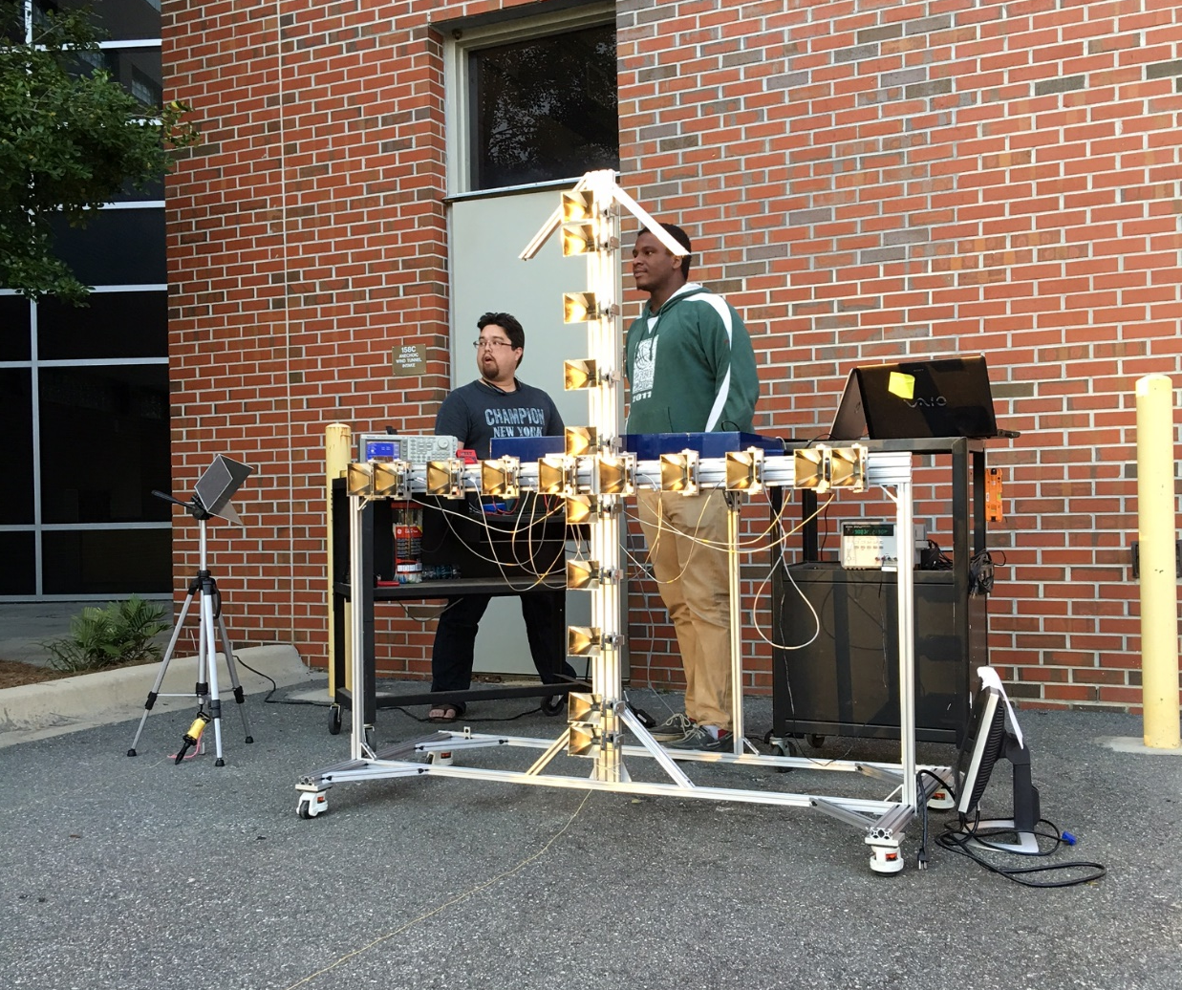
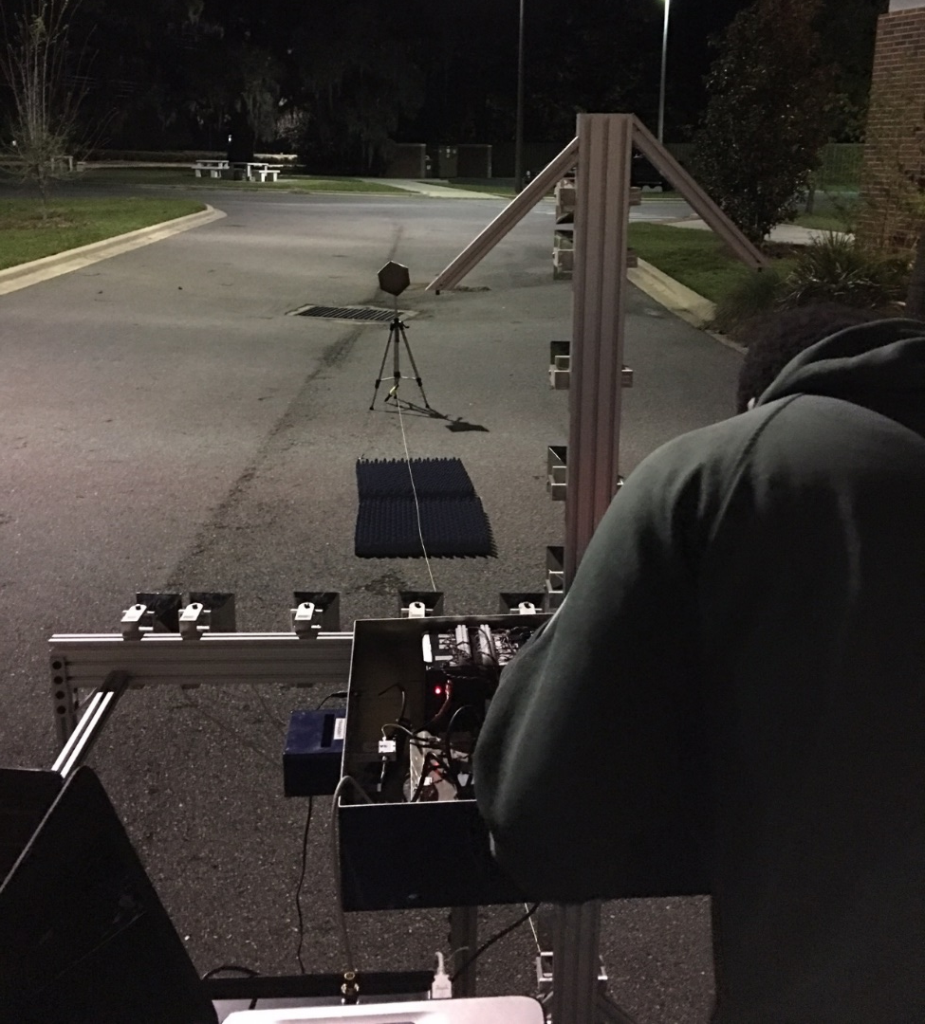
Questions?

Slide 64
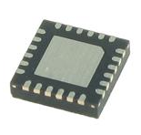
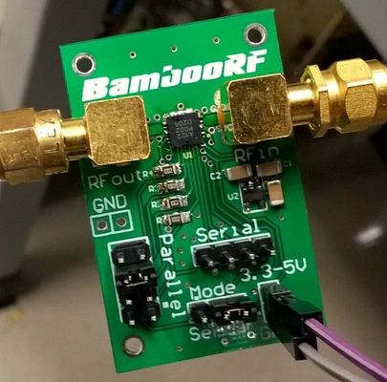




Existing
SAR Array
Drop-in Phased Array Module
$$Phase Shifter φ_{1}$$
$$Phase Shifter φ_{2}$$
COTS Phase Shifters
Phase Slope
$$Phase Shifter φ_{3}$$
Detector
$$Phase Shifter φ_{4}$$

Slide 65
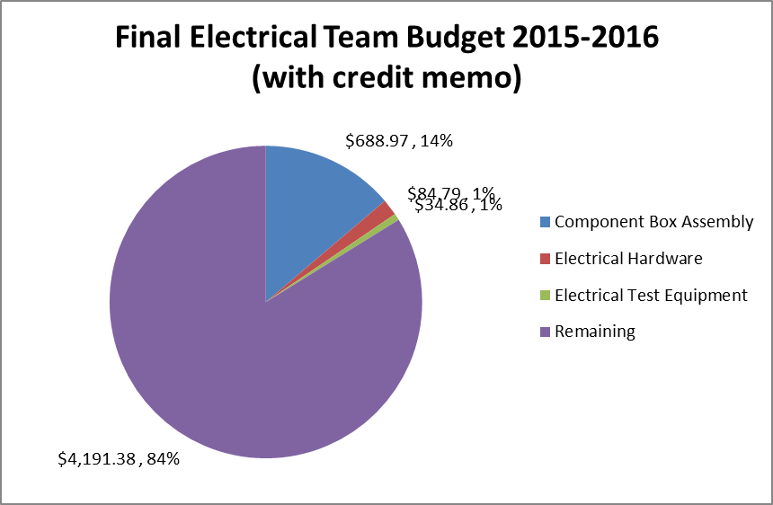
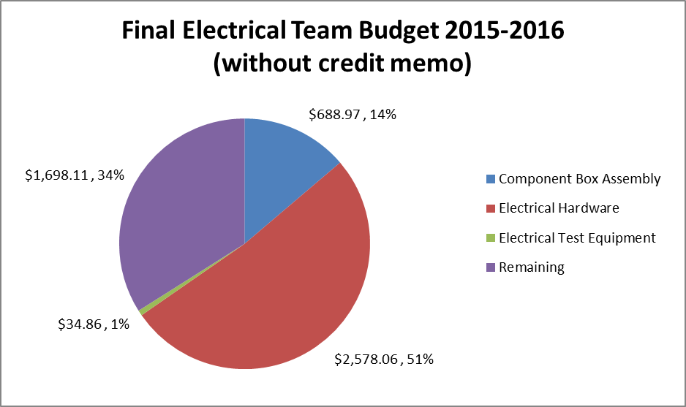
ECE Budget Supplement

Slide 66
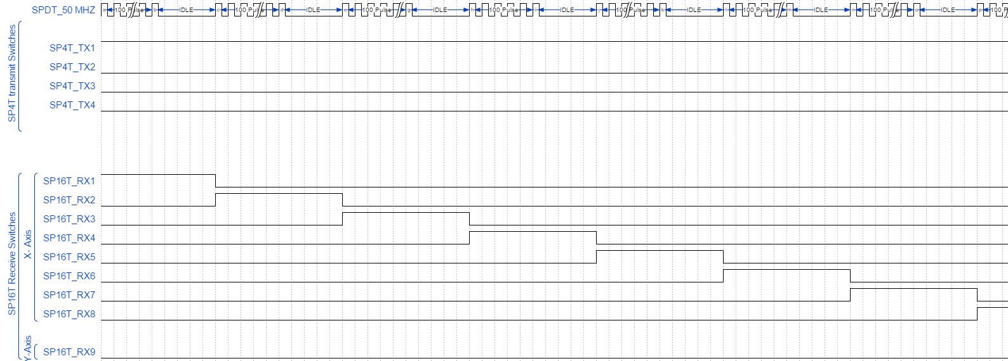
Switching Diagram
Olivier Barbier

Slide 67
Design Overview
Objective
  Develop a static, multi-antenna Synthetic Aperture Radar (SAR) Imager
Specifications
Low resolution proof of concept prototype
10 GHz operating frequency
20 feet range
40” x 40” downrange scene
Safety
RF Exposure Safety Guidelines
  ANSI/IEEE C95.1-1992
  FCC 47 C.F.R. 1.1307(b), 1.1310, 2.1091, 2.1093
Limit for human exposure: 1 mW/cm²
SAR Peak Transmit: 0.0076 mW/cm²

Slide 68
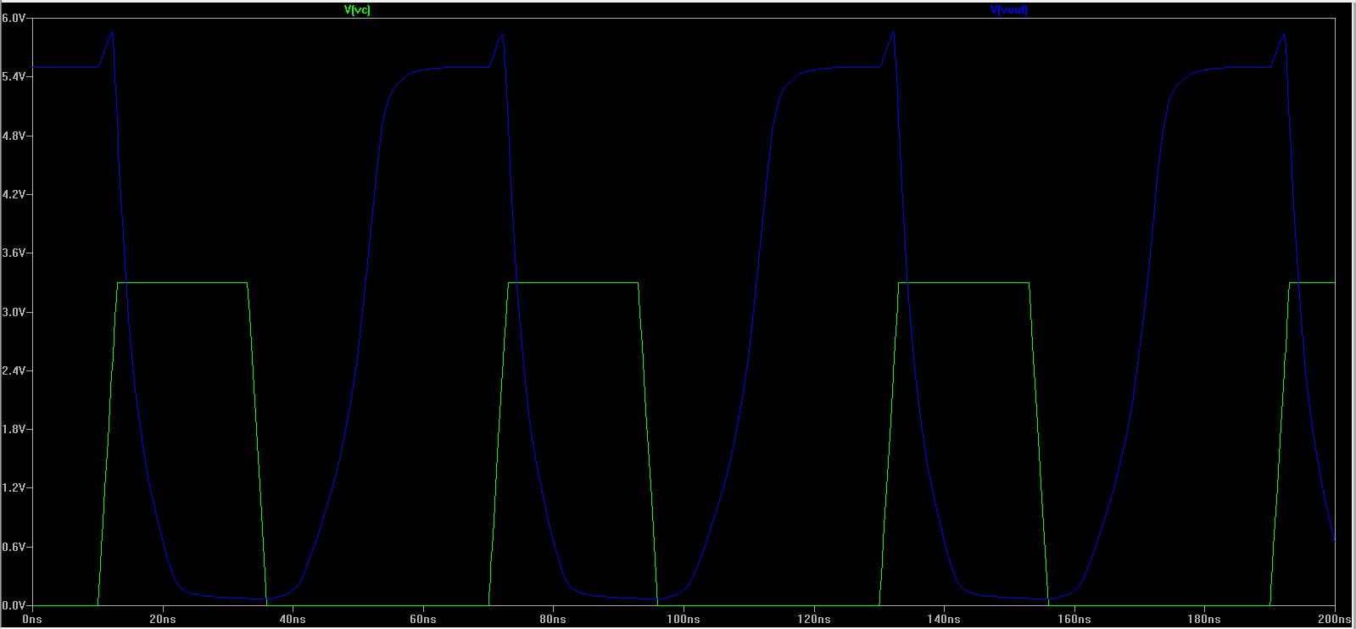
Obstacles(Continue)
MOSFET Circuit Output
Voltage
Time

